Slide 1
Preparing for The Road
Further Information

Slide 2
Terms
Nuclear Power - Electric or motive power generated by a nuclear reactor
Radiation - The emission of energy as electromagnetic waves or as moving subatomic particles.
Nuclear Weapon - a weapon of mass destruction whose explosive power derives from a nuclear reaction

Slide 3
Nuclear Power
Nuclear power plants provided 12.3 percent of the world's electricity production in 2011.
The USA is the world's largest producer of nuclear power, accounting for more than 30% of worldwide nuclear generation of electricity.
The country's 104 nuclear reactors produced 821 billion kWh in 2011, over 19% of total electrical output. There are now 103 units operable and three under construction

Slide 4
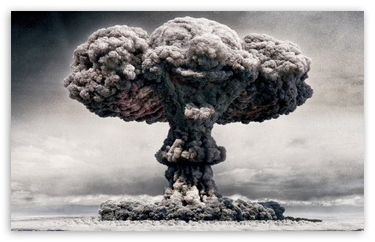
Mushroom Cloud
the large mushroom-shaped cloud of dust, debris, etc. produced by a nuclear explosion

Slide 5
Bombing of Japan
On August 6, 1945, the United States used a massive, atomic weapon against Hiroshima, Japan. This atomic bomb, the equivalent of 20,000 tons of TNT, flattened the city, killing tens of thousands of civilians. While Japan was still trying to comprehend this devastation three days later, the United States struck again, this time, on Nagasaki.
Approximately 40 percent of Nagasaki was destroyed. Luckily for many civilians living in Nagasaki, though this atomic bomb was considered much stronger than the one exploded over Hiroshima, the terrain of Nagasaki prevented the bomb from doing as much damage. Yet the decimation was still great. With a population of 270,000, approximately 70,000 people died by the end of the year.

Slide 6
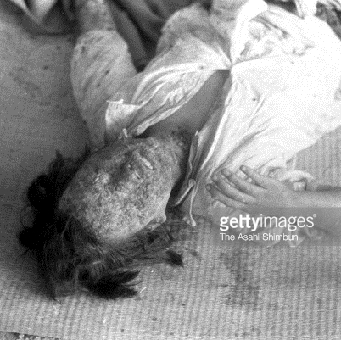
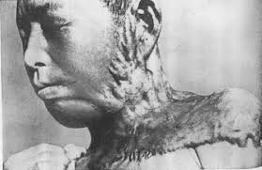
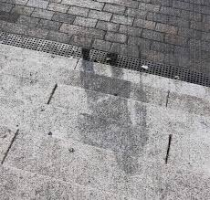
Victims of nuclear bombing

Slide 7
You Tube Fun!
The Day After
Duck and Cover

Slide 8
The Road By Cormac McCarthy
What matters most when the world ends?

Slide 9
Essential Questions
Can we maintain humanity in a post-apocalyptic world?
How do an author’s choices affect our mood as we read?
How do literary devices help us understand how a novel’s theme develops?

Slide 10
Post-Apocalyptic Fiction
What is it?
What can we expect when reading the novel?

Slide 11
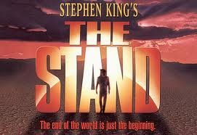
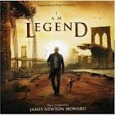
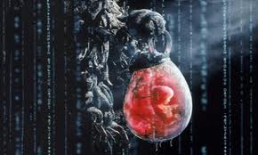
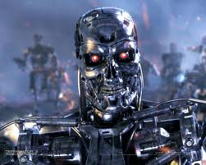
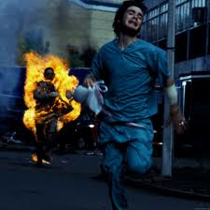
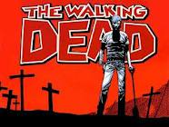
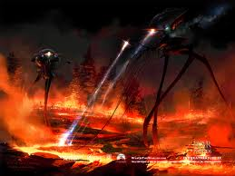
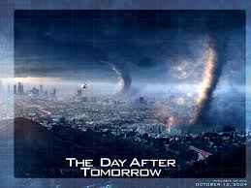
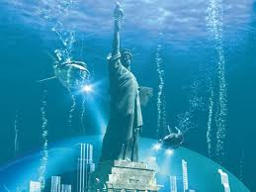
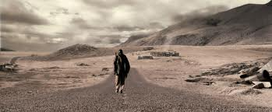
Brainstorm
Make a list of as many movies, songs, stories or poems that deal with the end of the world.

Slide 12
Possible Themes to Look For While we Read
Struggling to survive extinction in order for life to reemerge
Living a good and altruistic life despite the harshness of the world
Intentionally withholding information to shelter and protect
Man’s attempt to overcome nature’s obstacles
The sacrificial demands of a father’s love

Slide 13
Important Literary devices
Allusion
Symbol
Tone
Mood-how the reader feels about the subject
Syntax-the construction of sentences
Diction-word choice

Slide 14
Author’s Style
3rd person omniscient narrator
Narrator knows almost everything
Omits personal details
Protagonists’ Names
Other facts: how the world “ends”
Uses short and choppy sentences
Create confusion?
Time jumps
Flashback/flash forward
No indention
Block Paragraphs
Objective tone
Audience forms own opinions
Sporadic punctuation
No commas/quotation marks

Slide 15
The Hero’s journey
Hero Video

Slide 16
It’s time to start Reading
And Now…

