Slide 1
Intro to Poetry

Slide 2
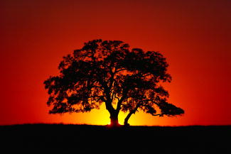
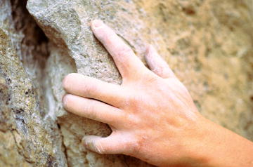
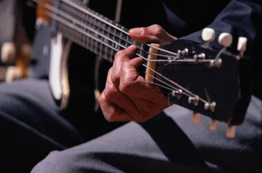
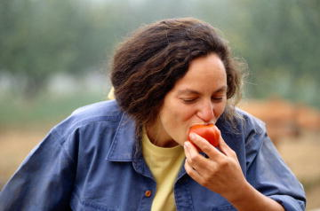
What Is Imagery?
An image is a representation of anything we can
touch
smell
see
taste
hear

Slide 3
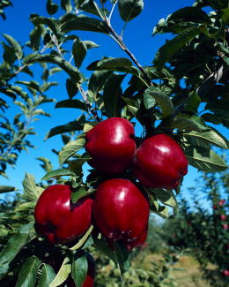
What Is Imagery?
Imagery is language that
appeals to our five senses
creates images in our minds
Give me the splendid silent sun, with all his beams full-dazzling;
Give me juicy autumnal fruit, ripe and red from the orchard;
Give me a field where the unmow’d grass grows;
Give me an arbor, give me the trellis’d grape;
from “Give Me the Splendid, Silent Sun” by Walt Whitman

Slide 4
What Is Imagery?
Quick Check
It must be on charcoal they fatten their fruit.
I taste in them sometimes the flavour of soot.
And after all really they’re ebony skinned:
The blue’s but a mist from the breath of the wind,
A tarnish that goes at a touch of the hand.
from “Blueberries” by Robert Frost
To which senses does this passage appeal?

Slide 5
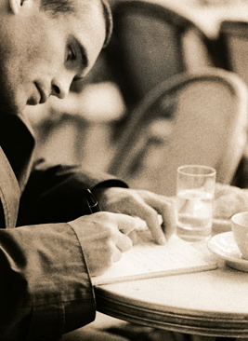
Rhythm in Poetry
Like music, poetry is based on rhythm—the alternation of stressed and unstressed sounds that makes the voice rise and fall.

Slide 6
Rhythm in Poetry
Poetic rhythm can take the form of
meter a strict rhythmic pattern of stressed and unstressed syllables in each line
free verse a loose kind of rhythm that sounds like natural speech
[End of Section]

Slide 7
Meter
In metrical poetry, stressed and unstressed syllables are arranged in a regular pattern.
The mountain mists, condensing at our voice
Under the moon, had spread their snowy flakes,
From the keen ice shielding our linkèd sleep.
from “Prometheus Unbound” by Percy Bysshe Shelley
˘ ’ ˘ ’ ˘ ’ ˘ ’ ˘ ’
˘ ’ ˘ ’ ˘ ’ ˘ ’ ˘ ’
˘ ˘ ’ ’ ’ ˘ ˘ ’ ˘ ’
’ = stressed syllable ˘ = unstressed syllable

Slide 8
Meter
Marking the stressed (′) and unstressed (˘) syllables of each line is called scanning a poem.
The mountain mists, condensing at our voice
Under the moon, had spread their snowy flakes,
From the keen ice shielding our linkèd sleep.
from “Prometheus Unbound” by Percy Bysshe Shelley
˘ ’ ˘ ’ ˘ ’ ˘ ’ ˘ ’
˘ ’ ˘ ’ ˘ ’ ˘ ’ ˘ ’
˘ ˘ ’ ’ ’ ˘ ˘ ’ ˘ ’

Slide 9
Meter
Metrical poetry is made up of metrical units called feet. A foot consists of at least one stressed syllable and usually one or more unstressed syllables.
Five Metrical Feet | Single-Word Examples
iamb | insist
trochee | double
anapest | understand
dactyl | excellent
spondee | football
˘ ’
’ ˘
˘ ˘ ’
’ ˘ ˘
’ ’

Slide 10
Free Verse
Free verse is poetry that does not have a regular meter or rhyme scheme.
Never, in all your career of worrying, did you imagine
what worries could occur concerning the flying cat.
You are traveling to a distant city.
The cat must travel in a small box with holes.
—from “The Flying Cat” by Naomi Shihab Nye
Because it is “free” of metric rules, free verse sounds more like prose or everyday speech than formal poetry.
The Imagists
[End of Section]

Slide 11
Rhyme
Rhyme is the repetition of the accented vowel sound and all subsequent sounds in a word.
Listen to this excerpt. What words rhyme?
A slumber did my spirit seal;
I had no human fears:
She seemed a thing that could not feel
The touch of earthly years.
from “A Slumber Did My Spirit Seal” by William Wordsworth

Slide 12
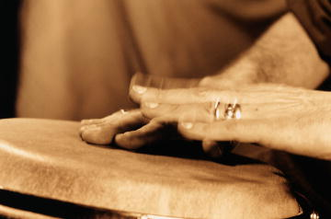
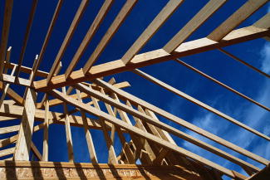
Rhyme
The chiming sounds of rhyme
punctuate the poem’s rhythm
give the poem structure
make the poem easier to remember

Slide 13
Rhyme
End rhyme is rhyme that occurs at the ends of lines.
This knowledge, from an Angel's voice
Proceeding, made the heart rejoice
—from “The Pilgrim’s Dream” by William Wordsworth
Internal rhyme is rhyme within a line.
The sails at noon left off their tune,
—from “The Rime of the Ancient Mariner” by Samuel Taylor Coleridge

Slide 14
Rhyme
Rhymes may be exact or approximate.
In an exact rhyme, the words rhyme perfectly.
In an approximate rhyme, the sounds are similar but not exactly the same.
heart—start
flicker—thicker
ordering—bordering
light—late
whisper—winter
bays—waves

Slide 15
Alliteration and Onomatopoeia
Alliteration is the repetition of consonant sounds in words that appear close together.
Listen to this excerpt. What consonant sound is repeated?
A long, long yellow on the lawn,
A hubbub as of feet;
Not audible, as ours to us,
But dapperer, more sweet;
from “A long, long yellow on the lawn” by Emily Dickinson
More about alliteration

Slide 16
Alliteration and Onomatopoeia
Onomatopoeia is the use of words that sound like what they mean.
Here the water went down, the icebergs slid with gravel, the gaps and the valleys hissed
from “Prairie” by Carl Sandburg

Slide 17
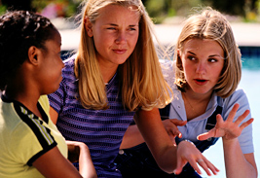
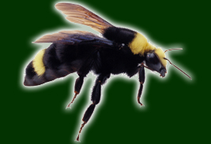
What Is Figurative Language?
Figurative language is language based on some sort of comparison that is not literally true.
Suzie’s endless gossiping droned in our ears like the buzzing of a bee.
=

Slide 18
What Is Figurative Language?
Figurative language
is a natural part of everyday speech
is the most important means of imaginative expression in poetry
makes us see ordinary objects in a new way
Snowed in for three days, the children were restless animals pacing the cage of our house.
[End of Section]

Slide 19
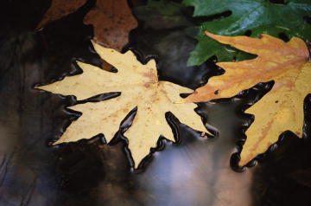
Figures of Speech
A figure of speech compares one thing to another, seemingly unlike thing. Three common figures of speech are
leaves twirled like dancers on the water
simile
metaphor
personification
the leaves were dancers twirling down the stream
leaves danced on the water
[End of Section]

Slide 20
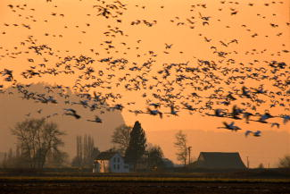
Simile
Similes use the word like, as, than, or resembles to compare two seemingly unlike things.
A wind comes from the north
Blowing little flocks of birds
Like spray across the town.
from “Patience” by D. H. Lawrence
[End of Section]

Slide 21
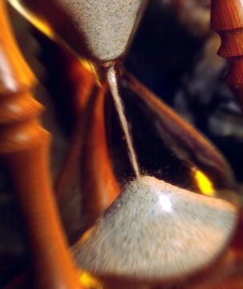
Metaphor
Metaphors compare two unlike things without using the connective like, as, than, or resembles.
Metaphors allow us to speak and write in a kind of imaginative shorthand.
I am soft sift
In an hourglass
from “The Wreck of the Deutschland” by Gerard Manley Hopkins

Slide 22
Metaphor
“I am a rock. I am an island.”

Slide 23
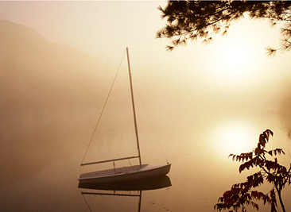
Metaphor
Direct metaphors say that something is something else.
My soul is an enchanted boat
from “Prometheus Unbound” by Percy Bysshe Shelley

Slide 24
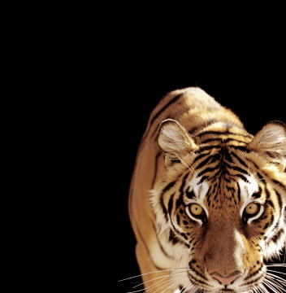
Metaphor
Implied metaphors suggest a comparison between two things instead of stating it directly.
He picked up the scent of food from the cafeteria. Stay out of his way. He’s on the prowl for a hot meal.
Even single words can contain implied metaphors.
Tiger, tiger, burning bright In the forests of the night
from “The Tiger” by William Blake

Slide 25
Metaphor
Extended metaphors are developed over several lines of a literary work.
All the world's a stage, And all the men and women merely players. They have their exits and their entrances; And one man in his time plays many parts, His acts being seven ages.
from As You Like It by William Shakespeare
[End of Section]

Slide 26
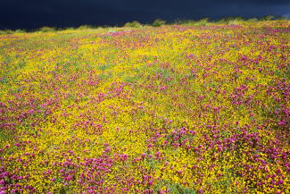
Personification
Personification is a figure of speech in which a nonhuman thing or abstract idea is talked about as if it were human.
Somewhere the wind-flowers fling their heads back,
Stirred by an impetuous wind.
from “Study” by D. H. Lawrence
Personification in everyday speech
[End of Section]

Slide 27
Symbolism
“The words of the prophets are written on the subway walls and tenement halls"

Slide 28
Hyperbole
Drowning in my loneliness/How long must I hold my breath
So much emptiness inside/I could fill the deepest sea

Slide 29
Irony
“I hate everything about you/Why do I love you?”

Slide 30
Idiom
The overall expression of the saying is different than the meaning of the actual words

