Slide 1
Short Stories
Irony

Slide 2
Irony
The difference between:
what is said & what is meant
what is said & what actually occurs
what the meaning is & what is understood

Slide 3
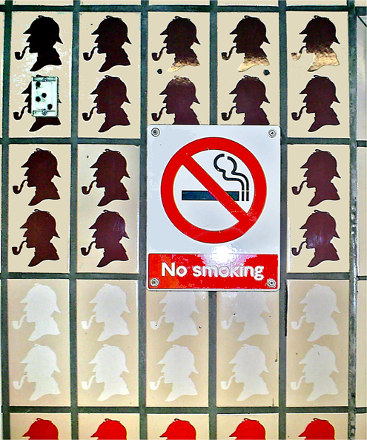
Situational Irony
Definition:
When the result of an action is contrary to the desired or expected effect.
Example:
The assassination attempt made on President Ronald Reagan by John Hinckley. The bullets initially missed the President. However, one of the bullets ricocheted off the bullet proof limousine and struck the President on the chest.

Slide 5
https://www.youtube.com/watch?v=tqg6RO8c_W0

Slide 6
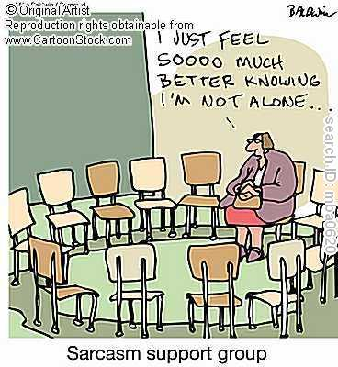
Verbal Irony
Definition:
When a speaker says one thing but means another OR When the literal meaning is contrary to its intended meaning
Example:
"The day was as normal as a group of seals with wings riding around on unicycles, assuming that you lived someplace where that was very normal.“
BEING SARCASTIC

Slide 7
Example
http://www.youtube.com/watch?v=lmSBrmgdKts
https://www.youtube.com/watch?v=IiR-bnCHIYo

Slide 8
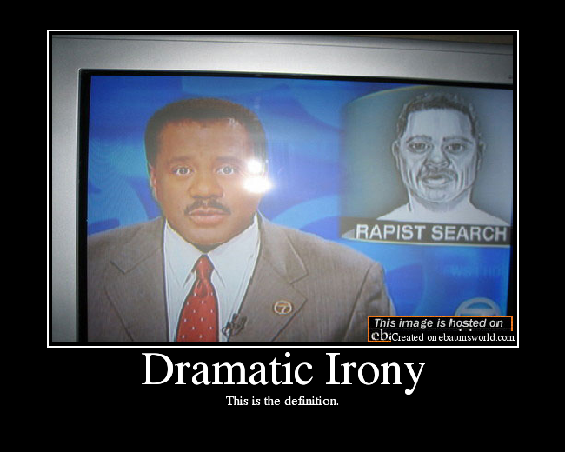
Dramatic Irony
Definition:
When the audience or reader knows a fictional character is making a mistake because the reader/audience has more information than the character
Example:
Any scary movie: the audience always know that the killer is hiding in the closet

Slide 9
Dramatic Irony Example
https://www.youtube.com/watch?v=fiFa_P9DApo

Slide 10
Irony creates….
Ambiguity
the element of uncertainty in a text, in which something can be interpreted in a number of different ways.

Slide 11
Allusion
Referencing a well known piece of literature, music, art, etc.

